Slide 1
Attendance by Face recognition project
Students
K sohan sunny 23011MB513
M Akhil reddy 23011MB501
J Ram Kishore Yadav 22011M2106
Mentor :- Dr. K Suresh babu

Slide 2
INDEX
INTRODUCTION
PROBLEM STATEMENT
EXISTING SYSTEM
PROPOSED SYSTEM
SYSTEM ARCHITECTURE
SYSTEM REQUIREMENT SPECIFICATION
SNAPSHOTS
CONCLUSION

Slide 3
Introduction
Define what the project does:
The Face Recognition Attendance System is an application that automatically marks attendance by recognizing faces through a webcam.
It eliminates the need for manual attendance, saving time and reducing human errors.
The system uses Python along with OpenCV and the face_recognition library to detect and identify faces in real-time.
Mention motivation:
Reduce manual effort
Prevent attendance fraud
Save time.

Slide 4
Problem Statement
Manual attendance is time-consuming, especially in large groups.
Prone to human error such as incorrect entries or missed students.
No way to verify authentic identity — allows for proxy/fake attendance.
Lacks real-time logging — no record of exact time of arrival.
Difficult to analyze trends or generate reports from paper records.

Slide 5
Existing System
Manual Roll Call: Teachers typically take attendance at the beginning or end of the class.
Paper Register: Attendance is recorded in a physical register, usually
consisting of 10–15 pages.
Routine Practice: This process is followed daily in most institutions and is entirely manual.

Slide 6
Proposed System & Advantages
Face recognition system using webcam.
Automatically marks attendance in a csv file.
Timestamp included for each entry.
Marks students as present or late based on time.
No human intervention needed during the process.
User-friendly and scalable for larger environments.

Slide 7
Software Requirements Specification
TECHNOLOGIES USED:-
1. Python
Core language for development.
Simple, readable, and has rich library support.
2. OpenCV (cv2)
Used to access and control the webcam
Performs image capture, resizing, and color conversion (BGR → RGB)
Helps display the webcam feed with face boxes and labels

Slide 8
3. face_recognition Library
Detects faces and encodes them into 128-dimensional feature vectors.
Compares faces for recognition.
4. NumPy
Handles mathematical operations and face distance calculations.
Helps process image data and face vectors efficiently.
5. OS Module
Read files from the clp/ image folder
Extract file names for student names

Slide 9
6. datetime Module
Gets the current date and time
Used to check Present or Late status
Logs timestamps for attendance records
7. CSV File Format
Stores attendance records in a file (attendance.csv)
Each entry has: Name, Date, Time, Status
Hardware Used:-
Web cam
Storage
laptop

Slide 10
System Architecture / Code Structure
Step 1: Load and encode known images (clp folder).
Step 2: Start webcam and scan for faces in real-time.
Step 3: Compare detected faces with known encodings.
Step 4: If matched, record attendance with date, time,
and status (Present/Late).
Step 5: Store results in attendance.csv.

Slide 11
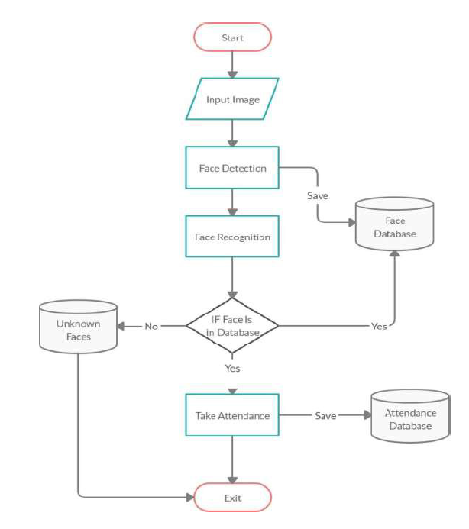
Flow Chart

Slide 12
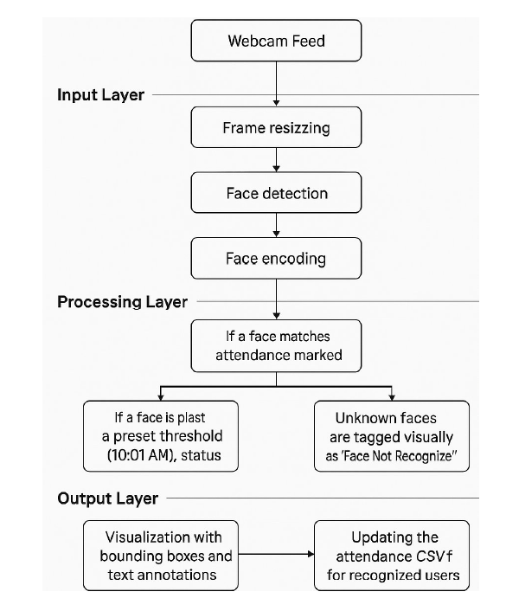
Sequence Diagram

Slide 13
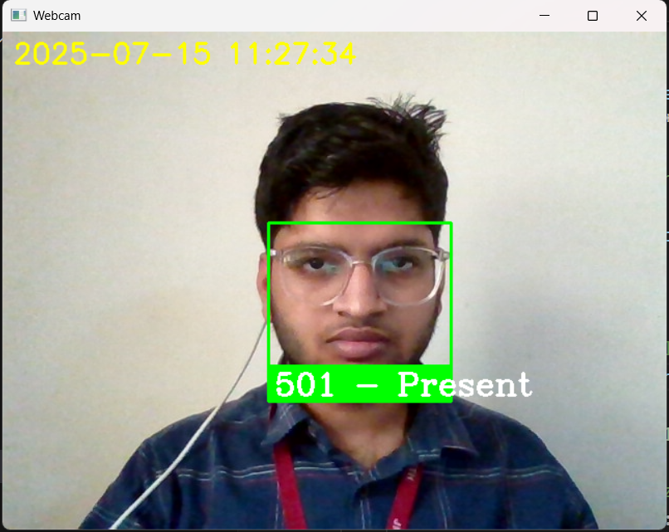
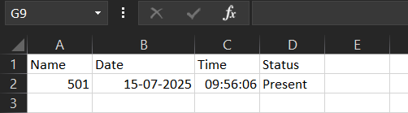
Snapshot of Project:
1) Known Single Student Face
Detecting face in web cam
Marking attendance in CSV file

Slide 14
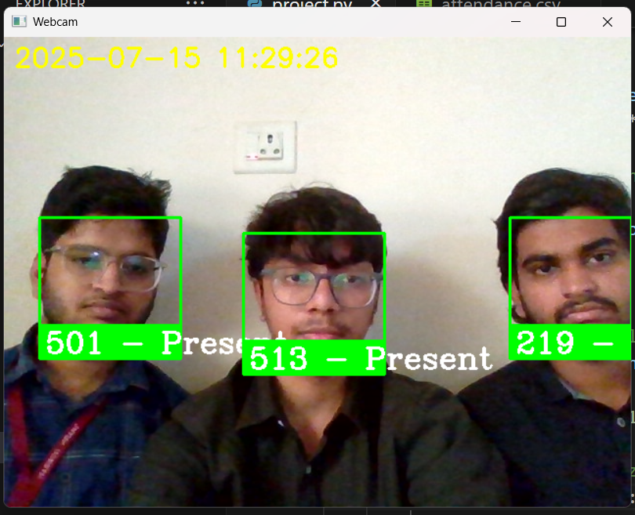
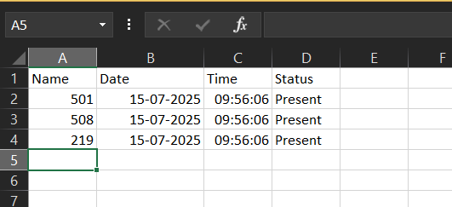
2) Group of Student Face’s
Detecting face in web cam
Marking attendance in CSV file

Slide 15
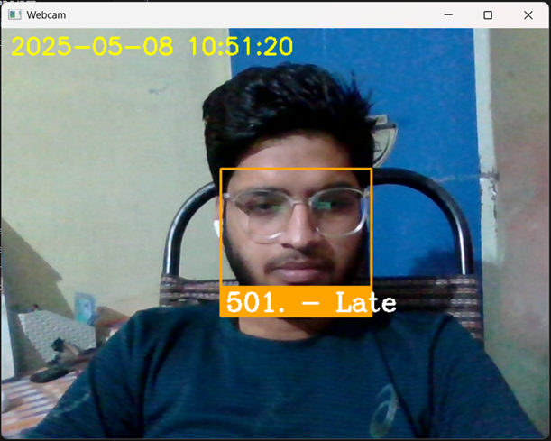
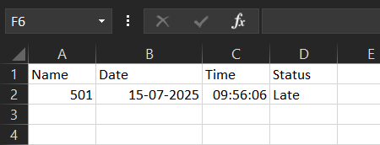
3)Not on Time
Detecting face in web cam
Marking attendance in CSV file as Late.

Slide 16
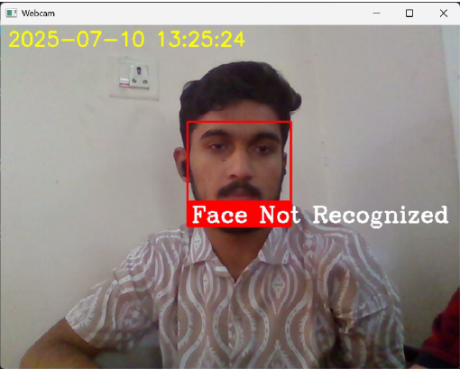
4) Unknown Face :-
Note :-
Unknow faces will not be marked.

Slide 17
Conclusion
The system NO manual work and improves attendance accuracy.
Provides real-time results and easy record management.
Suitable for classrooms, offices, or secure buildings.

Slide 18
Future Enhancements
Store attendance in a database (MySQL/PostgreSQL) instead of CSV.
Build a GUI/dashboard to view attendance logs.
Integrate with email/SMS to notify absentees or parents.
Face detection in low-light or occluded face conditions (e.g., masks).
Add mobile support or IoT integration (Raspberry Pi + camera).
Use machine learning to improve accuracy of recognition over time.
Attendance analysis reports (e.g., weekly, monthly trends).

Slide 19
THANK YOU

Slide 20
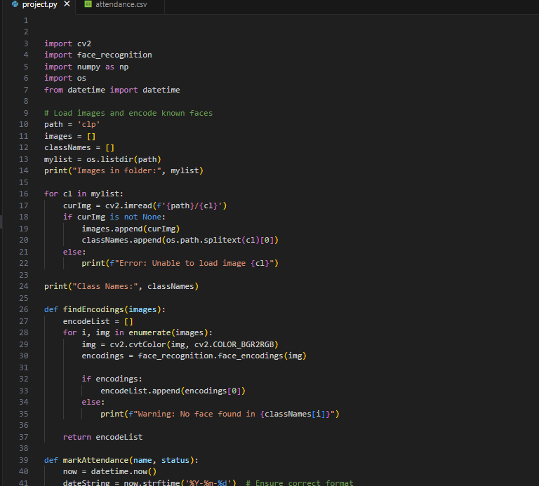

Slide 21
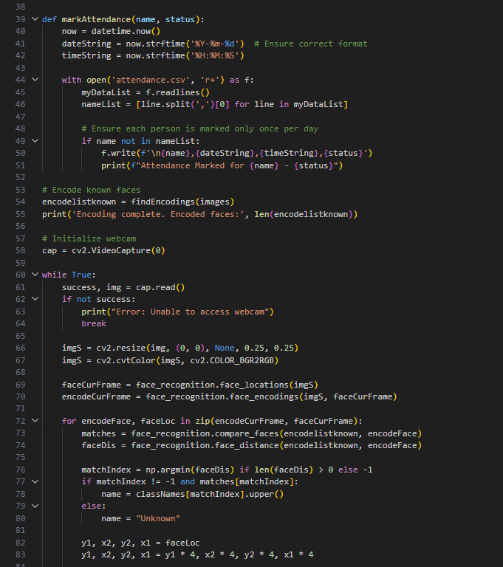

Slide 22
